Slide 1

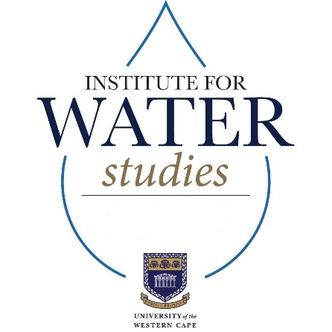

Determining Optimal NDWI and MNDWI Thresholds for Mapping Wetland Ecosystems Within the Cape Lowland Freshwater Wetlands using Remote Sensing and Cloud-Based Analysis
Odirile Mamba (3925922)
Supervisor: Prof. Timothy Dube
Co-Supervisor: Dr Siyamthanda Gxokwe
Institute for Water Studies, Department of Earth Science, University of the Western Cape

Slide 2
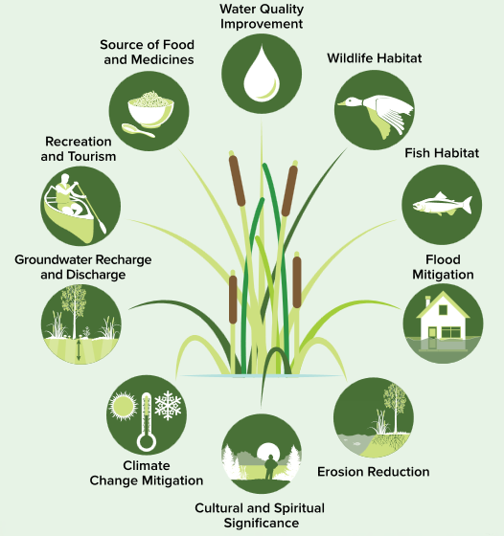
Background on Wetlands
Wetlands are useful, diverse and complex ecosystems.
Cover at least 5-10% of Earth Surface.
Provide the following ecosystem services (Figure 1):
Provisioning
Regulating
Supporting and
Cultural ecosystem services
Figure 1: Wetland Ecosystem Services. Source: Ontario Ministry of Natural Resources and Forestry. 2017. A Wetland Conservation Strategy for Ontario 2017–2030. Queen’s Printer for Ontario. Toronto, ON. 52 pp.

Slide 3
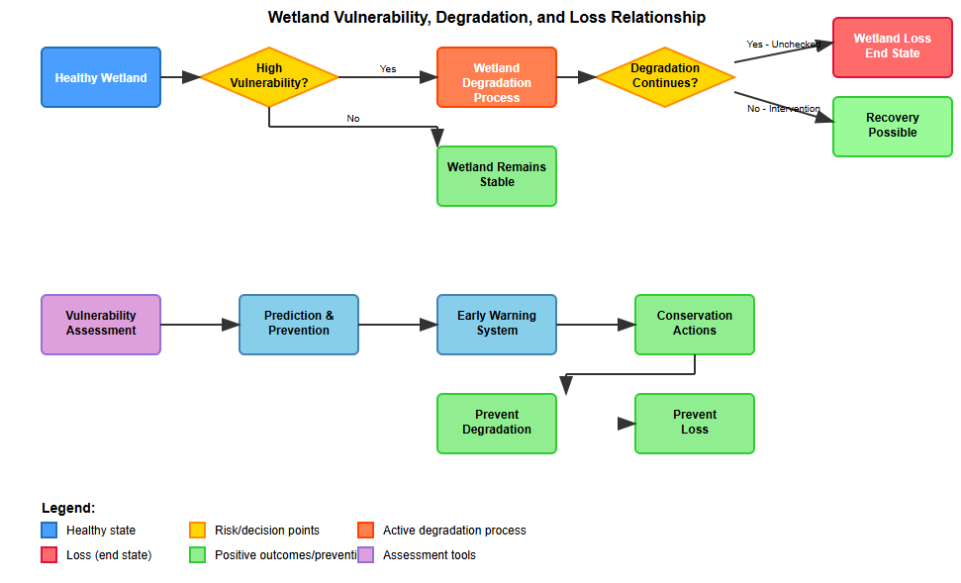
Wetland Vulnerability, Degradation and Loss
If wetlands are beneficial to communities and the environment what is the problem?
Wetland vulnerability, degradation and loss (Figure 2).
Evidence of Global wetland loss:
Over 60-80% inland wetlands have been lost .
Wetland loss intensified in 21st century.
In Africa:
Approximately 13,000 km2 wetlands face severe threats
while nearly 29, 000 km2 are exposed to moderate levels of human impact.
Figure 2: Relationship between wetland vulnerability, degradation and loss.

Slide 4
Aim and Objective
Aim and Objective:
To determine the optimal NDWI and MNDWI thresholds for accurately mapping wetland ecosystems occurring within the Cape Lowland Freshwater Wetlands vegetation type using remote sensing and cloud techniques.

Slide 5
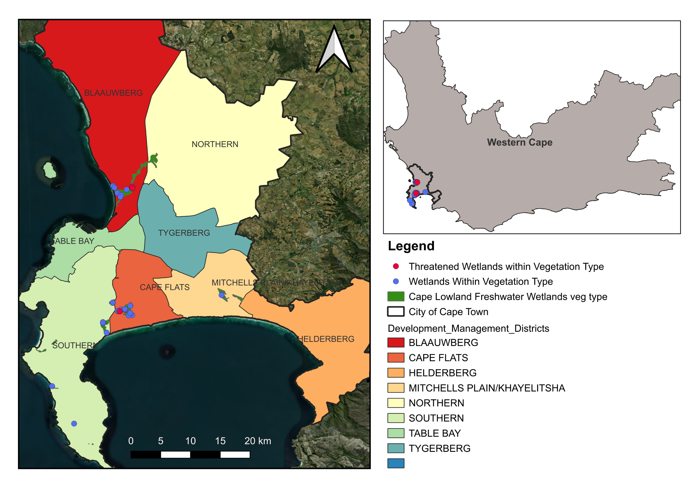
Study Area
Study area: located within Cape Metropolitan area, Western Cape, South Africa (Figure 3).
Study area characteristics:
Climate: semi-arid Mediterranean climate, with cool, wet winters and hot, dry summers
Average annual rainfall of 515 mm
seasonal rivers: Diep, Liesbeek, Black, and Eerste Rivers
Wetlands: natural and artificial
Study area focus: Wetland ecosystems within Cape Lowland vegetation type.
Figure 3: Location of Study area

Slide 6
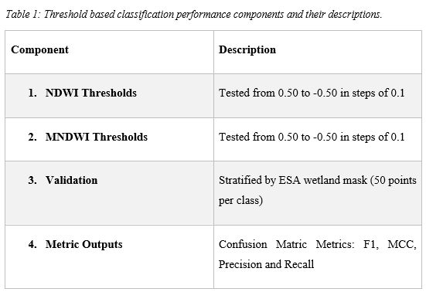
Methodology
To determine optimal thresholds suitable for the Cape lowland freshwater wetlands mapping in the Cape Town metropolitan area and their performance, two common water indices were calculated for the wet (May – September) and dry (October – April) season of 2023: NDWI (Normalized Difference Water Index) and MDNWI (Modified Normalized Difference Water Index).

Slide 7
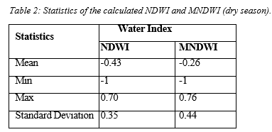
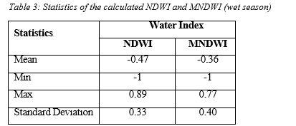
Results
1. Summary of NDWI and MNDWI Statistics
a)
Figure 4: NDWI and MNDWI value distribution for dry (a) and wet (b) season.
b)

Slide 8
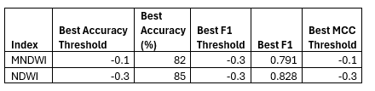
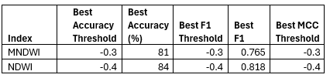
Results and Discussion
2. NDWI and MNDWI Optimal Thresholds (Dry and wet season).
Table 1: Optimal Thresholds Identification (Dry season).
Table 2: Optimal Thresholds Identification (wet season).

Slide 9
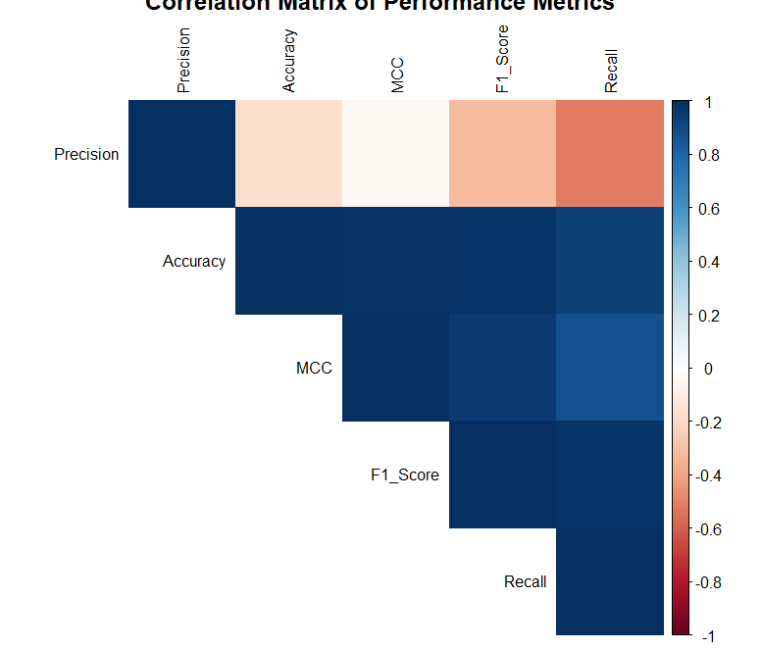
Results and Discussion
3. Best F1 score and correlation matrix – dry season
Table 4: Shows the best F1 - score results for the NDWI and MNDWI performance during dry season.
Metric | MNDWI at -0.3 Threshold | NDWI at -0.3 Threshold
Accuracy | 82% | 85%
F1- Score | 0.79 | 0.83
MCC | 0.67 | 0.73
Precision | 0.94 | 0.97
Recall | 0.68 | 0.72
True Positives (TP) | 34 | 36
True Negatives (TN) | 48 | 49
False Positives (FP) | 2 | 1
False Negatives (FN) | 16 | 14
Figure 5: Correlation Matrix plot of the performance Metrics - dry season.

Slide 10
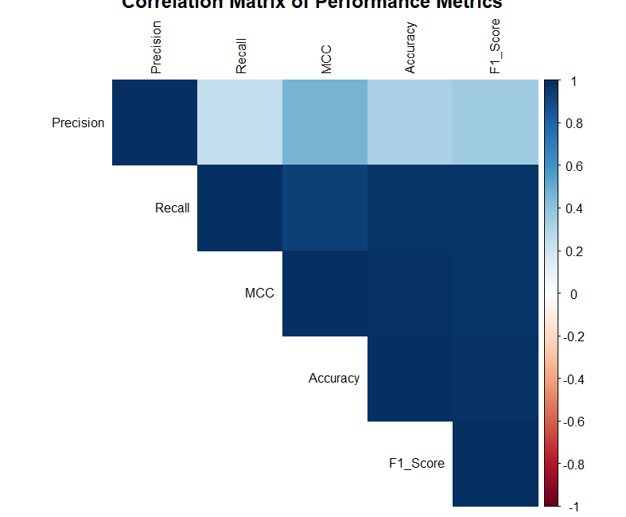
Results and Discussion
4. Best F1 score and correlation matrix – wet seasonBest F1 score and correlation matrix – wet season
Table 5: Shows the best F1 - score results for the NDWI and MNDWI performance during wet season.
Metric | MNDWI at -0.3 Threshold | NDWI at -0.4 Threshold
Accuracy | 81% | 84%
F1- Score | 0.77 | 0.82
MCC | 0.67 | 0.70
Precision | 1.00 | 0.95
Recall | 0.62 | 0.72
True Positives (TP) | 31 | 36
True Negatives (TN) | 50 | 48
False Positives (FP) | 0 | 2
False Negatives (FN) | 19 | 14
Figure 6: Correlation Matrix plot of the performance Metrics – wet season.

Slide 11
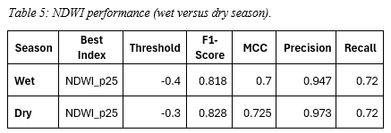
NDWI performance summary across seasons (dry versus wet)
The 25th percentile of NDWI values (NDWI_p25) gave the best classification results in both seasons.
NDWI consistently outperforms MNDWI in both seasons.
There is a threshold shift from -0.4 (wet season) and -0.3 (dry season) (Table 6).
Both seasons showed good balance between precision and recall; dry season slightly better.
Good overall classification performance, with slightly higher quality during the dry season.
Very high precision: most areas classified as wetlands were truly wetlands, especially in dry season.
72% of actual wetland areas were correctly detected in both seasons.
Table 6:NDWI performance (wet vs Dry season).

Slide 12
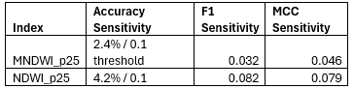
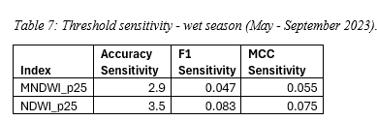
Threshold Sensitivity Analysis - wet and dry season
Table 7: showing the threshold sensitivity of the NDWI and MNDWI for dry season.
Table 8: showing the threshold sensitivity of the NDWI and MNDWI for wet season.

Slide 13
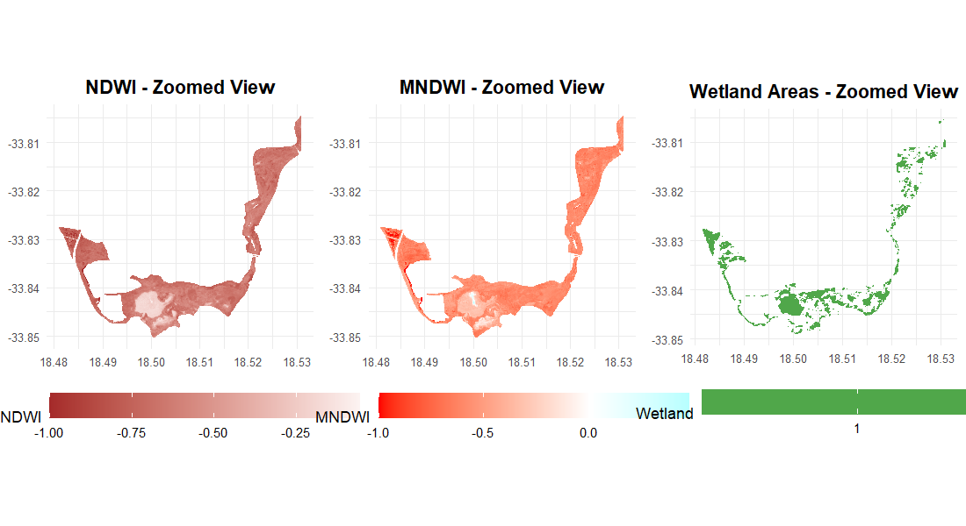
Wetland Area and Comparison of NDWI and MNDWI
Table 9: Total Wetland area of Cape Lowland wetlands using Optimal NDWI thresholds for wet and dry season.
 | NDWI threshold of −0.3 (Dry season) |  | NDWI threshold of −0.4 (Wet season)
Category | Area (km2) | Wetland Area Coverage (%) | Area (km2) | Wetland Area Coverage (%)
Wetland area | 3.342 | 29.8 | 3.312 | 29.5
Non-wetland area | 7.871 | 70.2 | 7.901 | 70.5
Total wetland area | 11.213 | 100 | 11.213 | 100
Table 10: Wet season wetland classification using an NDWI threshold of −0.3.
Category | Area (km2) | Wetland Area Coverage (%)
Wetland area (NDWI > 0.4) | 3.048 | 27.2
Non-wetland area (NDWI ≤ -0.4) | 8.165 | 72.8
Total wetland area | 11.213 | 100
Figure 7: Zoomed-in comparison of NDWI, MNDWI, and threshold-based wetland classification during the wet season. Despite low spectral index values due to vegetation cover and shallow water, the NDWI_p25 threshold of –0.4 effectively delineates wetland areas, demonstrating the utility of percentile-based thresholding for wetland detection in complex seasonal conditions.

Slide 14
Conclusion
This study aimed to determine the optimal NDWI and MNDWI thresholds for accurately mapping wetland ecosystems occurring within the Cape Lowland Freshwater Wetlands vegetation type using remote sensing and cloud-based techniques. Based on a comparative analysis of spectral indices, classification performance metrics, and mapped wetland extents across seasons, the following conclusions are drawn:
1. NDWI Outperforms MNDWI in Both Seasons.
NDWI consistently achieved higher classification performance metrics than MNDWI in both dry and wet seasons showing that NDWI is more sensitive and adaptable across seasonal variations in detecting wetland features.
2. Low Seasonal Variation in Wetland Area
Despite expectations, there was only marginal variation in surface water extent between dry and wet seasons.
This indicates reduced hydrological responsiveness, possibly due to wetland degradation or NDWI limitations.
3. Ecological Degradation Likely Suppressing Wetland Response
The lack of wetland expansion in the wet season suggests degraded hydrological function in the Cape Lowland Freshwater Wetlands.
Factors include urban encroachment, agriculture, and altered hydrology, leading to limited water retention and seasonal variability.
4. NDWI Threshold of -0.3 Shows High Transferability and Accuracy
NDWI at -0.3 threshold demonstrated high classification accuracy (up to 85%) and aligns with previous studies (e.g., Khac Manh et al., 2020), supporting its reliability and transferability for mapping small and seasonal wetlands using Sentinel-2 data.
5. Need to Integrate Remote Sensing with Ecological Context
The trade-off between classification performance and ecological interpretation emphasizes the need to combine remote sensing outputs with field-based ecological assessments, especially in fragmented and transformed wetland systems.

Slide 15
References
Assefa, W.W., Eneyew, B.G. and Wondie, A. (2022) ‘The driving forces of wetland degradation in Bure and Wonberma Woredas, Upper Blue Nile basin, Ethiopia’, Environmental Monitoring and Assessment, 194(11). Available at: https://doi.org/10.1007/s10661-022-10516-8.
Garba, S.I. et al. (2025) ‘Wetland fragmentation associated with large populations across Africa’, Nature Communications , 16. Available at: https://doi.org/10.1038/s41467-025-59373-2.
Thamaga, K.H., Dube, T. and Shoko, C. (2021) ‘An Assessment of Small Wetland Ecohydrological Dynamics Using Sentinel-2 MSI Derived Spectral Indices in Semi-Arid Environments of South Africa’. Available at: https://doi.org/10.21203/rs.3.rs-863296/v1.
Wood, K.A. et al. (2024) ‘A global systematic review of the cultural ecosystem services provided by wetlands’, Ecosystem Services. Elsevier B.V. Available at: https://doi.org/10.1016/j.ecoser.2024.101673.

